Slide 1










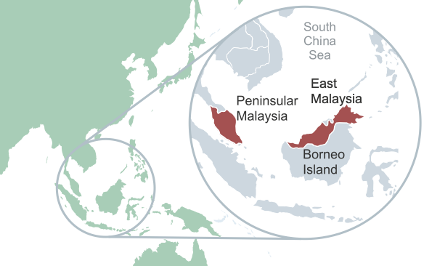






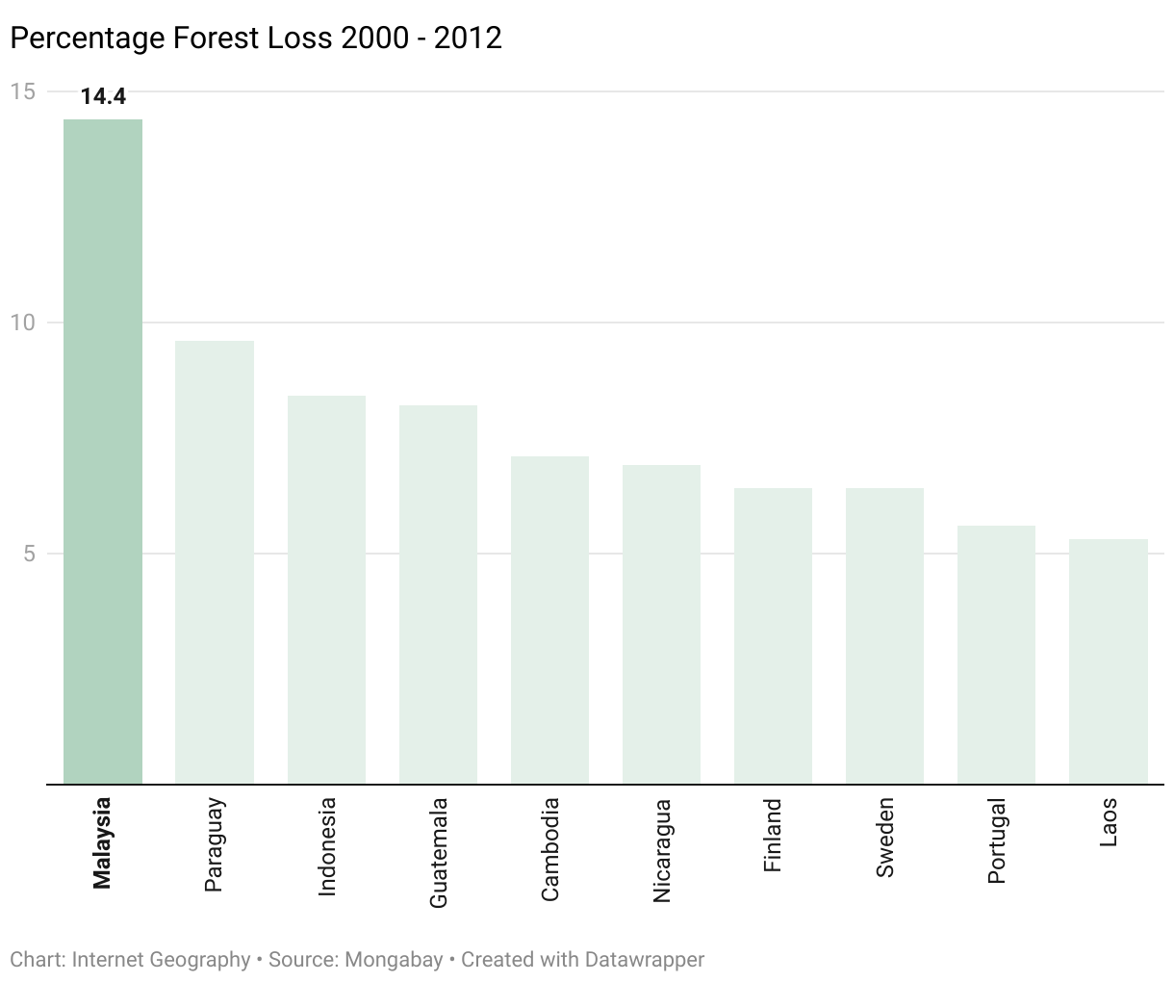




THE LIVING WORLD
Malaysia Rainforest Case Study
causes
read
quizzes
effects
The Big Picture
Causes of Deforestation
ecosystems
rainforests*
Agriculture – Malaysia is the second-largest producer of palm oil in the world.
The Living World
Logging – Hard wood (mahogany & teak) valued for furniture. Small trees pulped/charcoal.
cold environments
or
hot deserts
Road building – Increased accessibility encourages development e.g. in Sarawak.
Background
Mineral extraction – Bauxite mined in Peninsular Malaysia. Oil and Gas in Borneo.
Malaysia is in southeast Asia.
At 192,838 km², the Malaysian rainforest is the 24th largest in the world.
Energy development – High rainfall creates ideal conditions for HEP e.g. Bakun Dam, Sarawak.
Settlement and population growth – Trans-migration Policy – 15000 ha rainforest cleared.
Impacts of Deforestation
Economic Development
Raw materials used by processing industries increasing the value of exported products.
Commercial farming and mining generate employment and tax income.
Cheap, renewable energy = development.
Loss of biodiversity affects tourism.
Long-term economic losses due to forests being destroyed and rivers polluted.
Deforestation Rates
Deforestation Rates
Between 2000 and 2012 Malaysia had the highest deforestation rate in the world (by % area), losing 14.4% of its forest cover.
The rate of deforestation fluctuated between 2012 and 2015.
It steadily declined between 2016 and 2020.
Between 2001 and 2021 17% of rainforest cover was lost.
Social Impacts
Education, health care and social conditions are improved from tax revenue.
Decline in indigenous tribes e.g. Orang Asli.
Environmental Impact
Exposed land increases soil erosion
Decline in biodiversity
Climate Change
Local environment becomes hotter and drier.
Reduction in carbon sink due to deforestation.
Sustainable Management
International hardwood agreements
Ecotourism
Debt reduction
Strategies
Conservation and education
Selective logging and replanting

