Slide 1




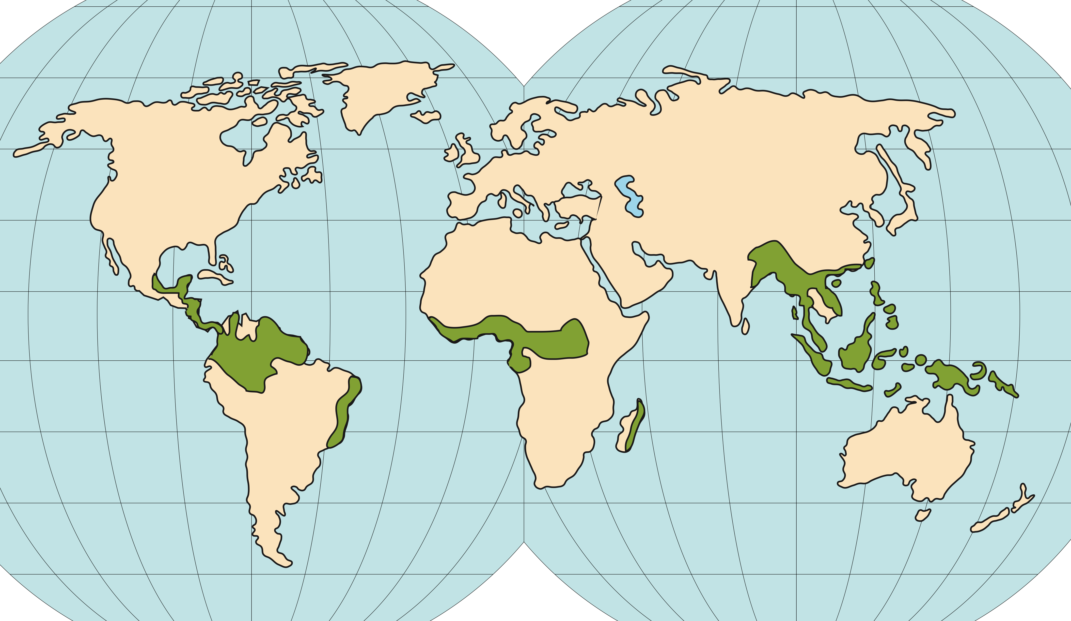









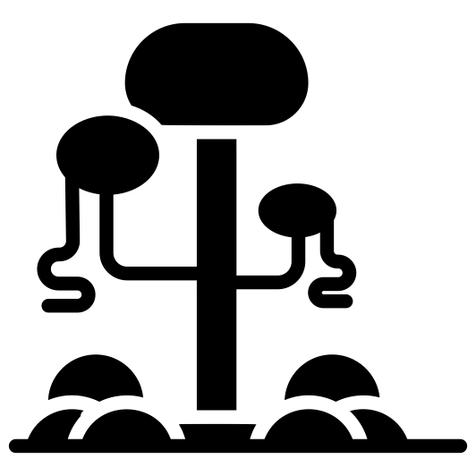





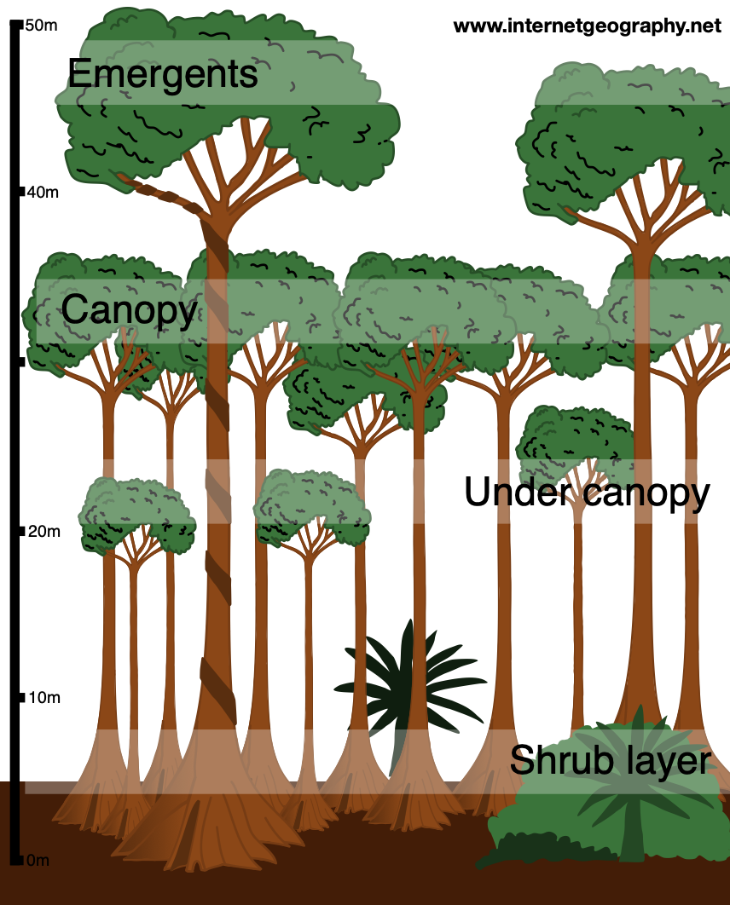


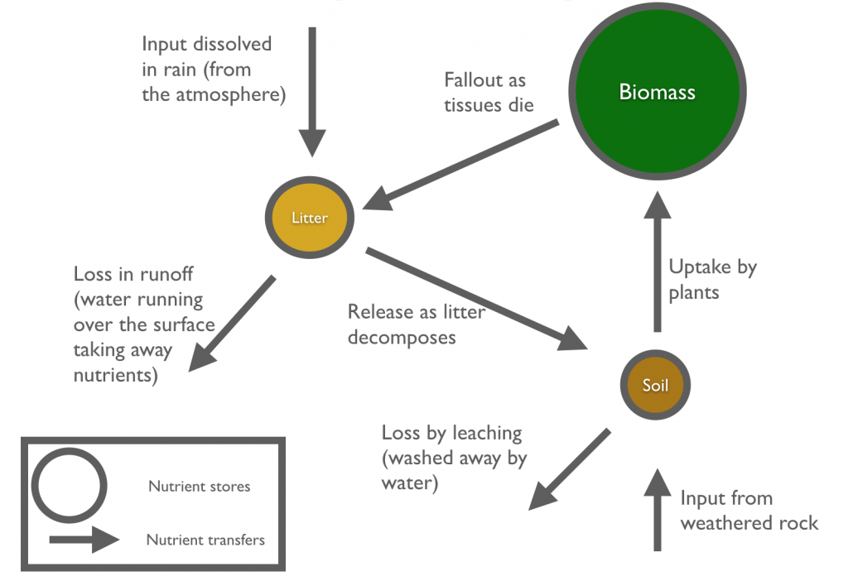
THE LIVING WORLD
Rainforests
read
quiz
The Big Picture
Location
ecosystems
rainforests*
10°N and 10°S
of the Equator
South America
(Amazon), the
DRC (Africa),
Indonesia &
Malaysia (Asia)
The Living World
cold environments
or
hot deserts
Key Terms
Characteristics
Biome – Areas of the planet with a similar climate and landscape, where similar animals and plants live.
Climate - High temperatures (27°C) and high rainfall (2000mm +)
Biodiversity – The variety of life in the world or a particular habitat.
Water – Distinct wet season lasting several months. Leaching during this time.
Commercial farming – Farming to sell produce for a profit.
Soil – Not very fertile. Nutrients concentrated in the topsoil & quickly absorbed.
Debt reduction – National debt relief
in return for protecting rainforests.
Biotic – Highest biodiversity in the world. Thousands of species of plants and animals.
Deforestation – The chopping down and removal of trees.
People – Traditional tribes live sustainably. Exploitation for $$ gain by non-indigenous.
Ecotourism – Responsible travel to natural areas that conserves the environment and benefits locals.
Adaptations
Logging – Cutting down trees and selling the timber.
Emergents and lianas grow to
reach the sunlight.
Soil erosion – Removal of topsoil faster than it can be replaced.
Buttress roots anchor the trees
in the shallow soil.
Sustainability – Progress meting todays needs with affecting future generations.
Smooth bark to deter epiphytes.
The Nutrient Cycle
Plants have thick, waxy leaves & drip tips to channel water.
Poison Dart Frog - bright colours deter predators.
Sloths - long, sharp claws that help them cling onto branches.
Spider Monkey - prehensile tail to be able to grasp the branches of trees.
Jaguars - large claws, which enable them to climb small trees and catch their prey.

