Slide 1
























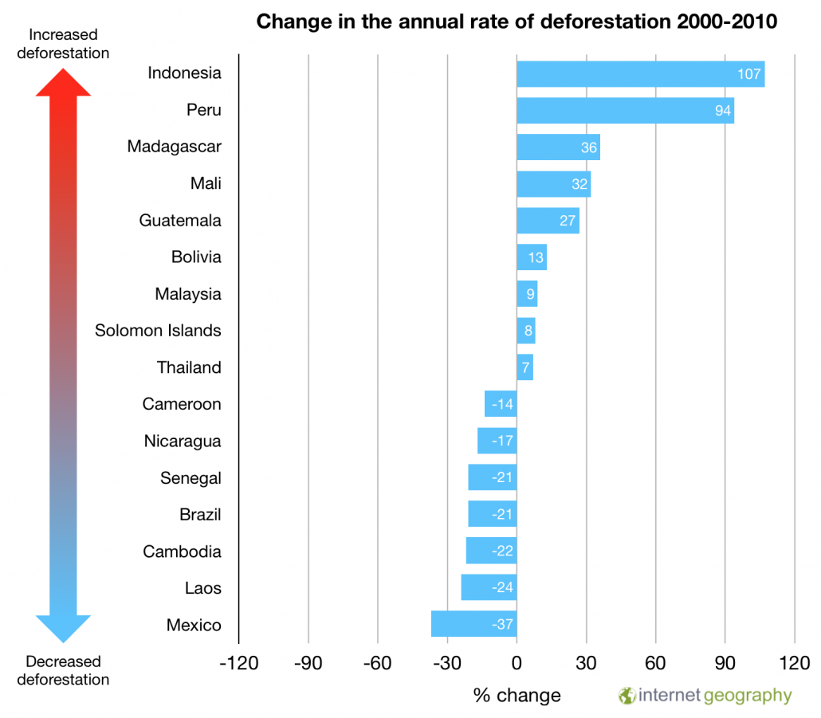



THE LIVING WORLD
Rainforests
read
quiz
The Big Picture
Causes of Deforestation
ecosystems
rainforests*
Logging – Hard wood (mahogany & teak) valued for furniture. Small trees pulped/charcoal.
The Living World
Road building – Increased accessibility encourages development e.g. Trans-Amazonian.
cold environments
or
hot deserts
Mineral extraction – Minerals (gold, bauxite, and copper) mined extensively.
Value
Services
Energy development – High rainfall creates ideal conditions for HEP.
Carbon sink
Settlement and population growth – Settlements developed to service developments.
Water and nutrient cycling
Protection against soil erosion
Wildlife habitats
Impacts of Deforestation
Biodiversity
Economic Development
Commercial farming and mining generate employment and tax income
Education, health care and social conditions are improved from tax revenue.
Raw materials used by processing industries increasing the value of exported products.
Cheap, renewable energy = development.
Long-term economic losses due to forests being destroyed and rivers polluted.
Loss of biodiversity affects tourism.
Employment opportunities
Goods
Native food crops (fruit and nuts)
Wild meat and fish
Building materials (timber)
Energy from hydro electric power
Water
Medicines
Soil Erosion
Exposed land increases soil vulnerability to soil erosion reducing fertility.
Deforestation Rates
Deforestation Rates
Climate Change
Local environment becomes hotter and drier.
Reduction in carbon sink due to deforestation.
Burning trees releases carbon dioxide.
Sustainable Management
International hardwood agreements
Ecotourism
debt reduction
Strategies
conservation and education
Selective logging and replanting

