Slide 1

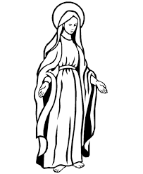


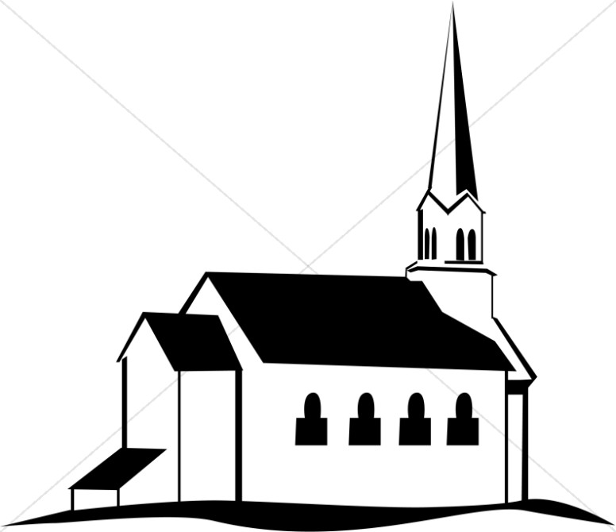
2. Prayer
Nature and purpose of prayer
To get closer to God and communicate with him
To praise God and thank him for what he has done
To ask for God’s help
To say sorry to God and ask for forgiveness
Set Prayers:
Prayers that are in a prayer book that are said at certain times, for example during a church service.
The Lord’s Prayer:
The most famous prayer. Known by most Christians
Informal Prayer:
Any prayer done personally and privately.
“Our Father who art in heaven, hallowed be thy name”
“Give us this day our daily bread. And forgive us our sins.”
3. Eucharist/Communion
This is a Church service that recreates Jesus’ last supper with his disciples. Members of the church come forward to receive bread and wine. The bread representing the body of Christ and the wine the blood.
The celebrates Jesus’ sacrifice through his death and resurrection
It is considered a sacrament, and outward sign of inner grace.
It remembers The Last Supper.
It brings the Christian Community together.
Catholics believe in transubstantiation. This means they believe the bread and wine literally become flesh and blood.
Most other Christians see the bread and wine as symbolic.
“This is my body Eat this and remember me.”
“This is my blood…drink this and remember me.”
5. Pilgrimage
A religious journey made
to a place of religious
importance.
Lourdes:
A town in France that Christians visit too remember the miracle performed by Saint Bernadette and to be healed by the waters.
Bernadette was said to have had visions of the Virgin Mary. She moved the mud at her feet and water appeared and is said to be a miracle.
Pilgrims visit the site to drink the waters in the hopes it will heal them and clear their sins.
Iona:
An island off the coast of Scotland, discovered by St. Colomba. Said to be so beautiful that it must be the creation of God.
Called the “thin place”, as the space between heaven and earth was so thin.
Christians go there on a residential to pray and fast in order to appreciate God and try and connect to Him.
They also complete chores, go on long walks to appreciate the area.
1. Worship
Liturgical – Follows a set routine e.g. RC
Non-liturgical - Does not follow a set routine
Informal – Can be anywhere following any pattern
Private – worshipping alone
Prayer – Communicating with God
Why is worship important?
It brings a sense of togetherness as a community
It makes a person feel closer to God
It is peaceful – allowing for prayer and meditation
It is an external expression of their faith.
11.Charity
CAFOD – Catholic Agency for Overseas Development – A religious charity which focuses on short and long term aid.
Tearfund – Water for developing countries. An emphasis on long term aid to help improve living conditions.
Christian Aid – Short term aid following disasters providing food, shelter, medical assistance.
“When I was hungry you gave me something to eat. When I was thirsty something to drink.”
4. Baptism
This Sacrament is rite of passage. A physical act, that Christians believe, has a permanent effect on the soul.
Infant Baptism:
A baby is taken to a church, where a priest or vicar will bless that child with holy water, making the sign of the cross upon them. Parent’s and God Parent’s are present, and a candle is lit. This welcomes the child into their Christian family, and cleanses the child of the Original Sin of Adam and Eve.
Adult /Believers Baptism
An adult, normally over 13, is asked questions about their faith. They are fully immersed (under water) to wash away their sins (not just original sin), and so they can start a new one in the church.
“Go and make disciples of all nations, baptising them in the name of the father the son and the Holy Spirit.
7. Role of the Church
The Church has always been involved in caring for others, a London church set up the first Samaritans phone service for those feeling suicidal. One way in to put their faith into action is food banks and street pastors.
Key organisations (research these!)
Corrymeela – reconciliation & ecumenism
Spring Harvest – Mission & evangelism
CAFOD – Catholic Agency for Overseas Development
Tearfund – Water for developing countries.
Christian Aid – Short term aid following disasters.
Street Pastors – Engage with those on the streets to care for them.
“For where two or three gather in my name, there I am with them.”
9. Reconciliation
Reconciliation means to come to peace and harmony after a conflict. As Jesus is the prince of peace he would want us to forgive others for their sins, as they are forgiven by God.
Corrymeela: An organization which works to promote peace and pacifism across the world. They go into places of conflict, e.g Northern Ireland, and provide safe spaces to promote peace.
Quakers also aim to do this by protesting against violence and wars. For example, they were very vocal surrounding the wars in Afghanistan and are inspired by the teaching, ‘blessed are the peacemakers.’
8. Evangelism and Missions
Evangelism: This is the spreading of the faith, often done by preaching the words of the gospel.
Mission: This is a specific journey to a place to help spread the religion. Often to a country or area of a different faith. A person who does this is called a Missionary.
Locally: Local Churches might fund work in the community, have open events at the church, have courses to welcome people to the faith.
Nationally: Churches may be linked together and hold events like summer camps, special events held for people of different faiths (interfaith Dialogue)
Globally: People choose to go to poorer areas to help with education, host concerts or TV shows about religion.
“Go into all the world and preach the gospel to all creation.”
10. Persecution
Persecution is how people are treated badly for their beliefs or other factors. Christians, historically, have been persecuted against.
Christians believe that they should work to overcome persecution, but also promote positive relationships.
Organisations like the Barnabas Fund work to identify areas where Christians are persecuted, and how to help them.

